Slide 1
The Terrapin Cuisine Crew
Restaurant Reviews In College Park
Siying Li Anran Wu Yiqing Pan Ben Caine Rohin Bhagavatula
12-6-21
Notes:
Title: project name, team information, date (Anran)
Background: who users are and what data/sources it includes (Anran)
Introduction: mission statement(s) and mission objectives (Ben)
Conceptual Database Design: ER diagram (Rohin)
Logical Database Design: relational schema (Rohin)
Physical Database Design: one SQL CREATE TABLE containing foreign key(s)Zoe
Use Cases: two business transactions with VIEW solution statements (Skylar) q2 & q3
Visualization screenshots on the results of the above two use cases (Skylar)

Slide 2
Content
Background
Mission statements and Mission objectives
Conceptual Database Design
Logical Database Design
Physical Database Design
Business Transactions
Visualization

Slide 3




Background
Users
Data
Customers who chose to place a review for one of our selected College Park MD restaurants
Restaurant, Review, Reviewer,
Cuisine, Features
From Yelp, Google, and Tripadvisor
Notes:
Customers who chose to place a review for one of our selected College, Park MD restaurants

Slide 4
Introduction
Mission Statements
To analyze online reviews of restaurants in College Park, MD in order to gain insights on restaurant ratings and customers
To collect, sort, and analyze the comment focuses of online restaurant reviews in order to assist database users in ordering from College Park, MD owned restaurants based on different dimensions
Notes:
Throughout our project, our goal has been to create an accessible and thorough database that offers users the abiltiy to find the perfect College Park restuarant of their liking
Our mission statements above further this, as we seeked to provide analysis on resturant ratings and their customers as well as focusing on sorting our data in a manner that allows users to select their restaurant of choi Ce， based on different dimensions

Slide 5
Introduction
Mission Objectives
To find the positive feedback rate of each restaurant in 2021 (4-5 )
To find the restaurant that offers the most features in College Park, MD
To find the average rating of each restaurant
To find which aspects of each restaurant are rated positively and negatively
Notes:
1 and 2 and 5 are little bit redundant, so they are not meanful. Maybe we could delete one of them(I prefer 5) and change 2 into : To find the advantages of each restaurant (I’ve already rewritten the code)

Slide 6
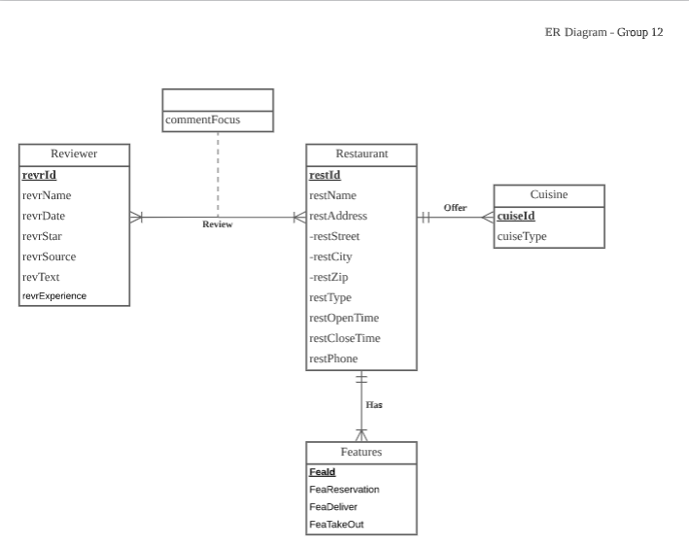
ER Diagram - LucidChart

Slide 7
Logical Database Design: Relational Schema
Relations:
Restaurant (restId, restName, restStreet, restCity, restState, restZip, restOpenTime, restCloseTime, restPhone)
Reviewer (revrId, revrName, revrDate, revrText, revrStar, revrSource, revrExperience, restId)
Cuisine (cuisId, cuisType, restId)
Features(FeaId, FeaReservation, FeaDeliver, FeaTakeOut, restId)
Review (restId, revrId, commentFocus)
Notes:
Relations:
Reviewer (revrId, revrName, revrDate, revrText, revrStar, revrSource, revrExperience, restId)
Restaurant (restId, restName, restStreet, restCity, restState, restZip, restOpenTime, restCloseTime, restPhone)
Cuisine (cuisId, cuisType, restId)
Features(FeaId, FeaReservation, FeaDeliver, FeaTakeOut, restId)
Review (restId, revrId, commentFocus)

Slide 8
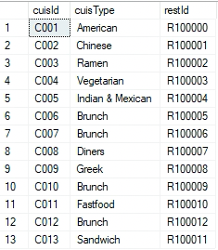
Physical Database Design
Create Table
CREATE TABLE [G12.Cuisine] (
cuisId CHAR(4),
cuisType VARCHAR(20),
restId CHAR(10),
CONSTRAINT pk_Cuisine_cuisId PRIMARY KEY (cuisId),
CONSTRAINT fk_Cuisine_restId FOREIGN KEY (restId)
REFERENCES [G12.Restaurant](restId)
ON DELETE CASCADE ON UPDATE CASCADE)
Notes:
integrity, security and recoverability

Slide 9
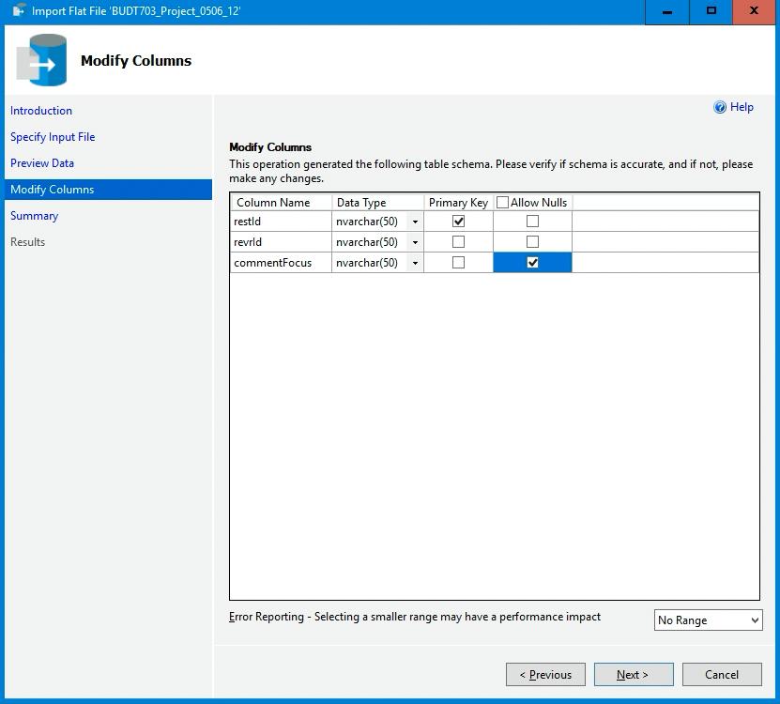
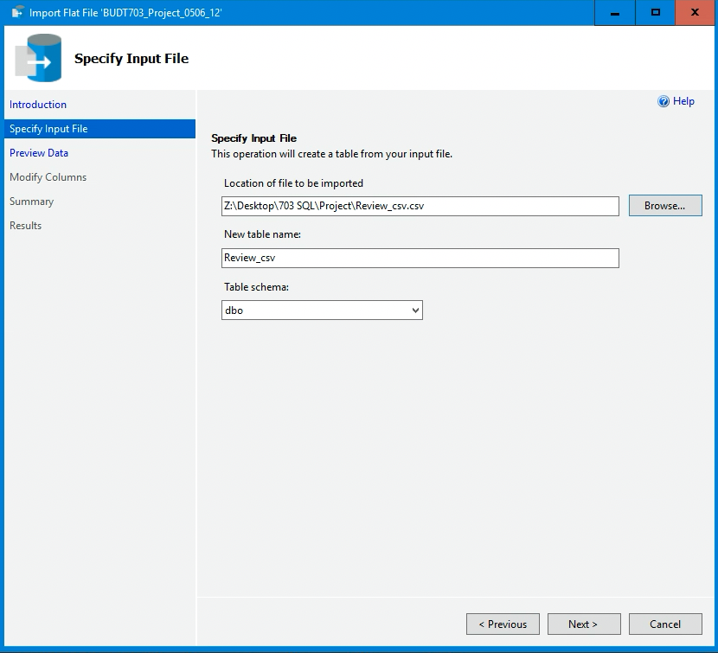

Physical Database Design
Import CSV file

Slide 10
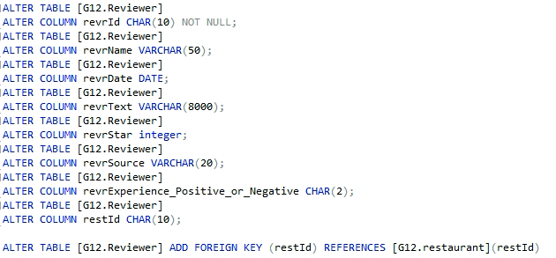
Physical Database Design
Change the data type and add the foreign key

Slide 11
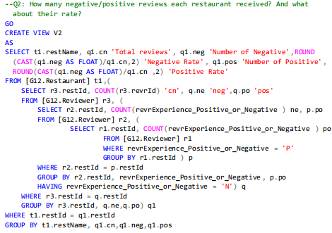
CASE 1: Business Transaction & Application
CASE 1: How many negative/positive reviews each restaurant received? And what about their rate?

Slide 12
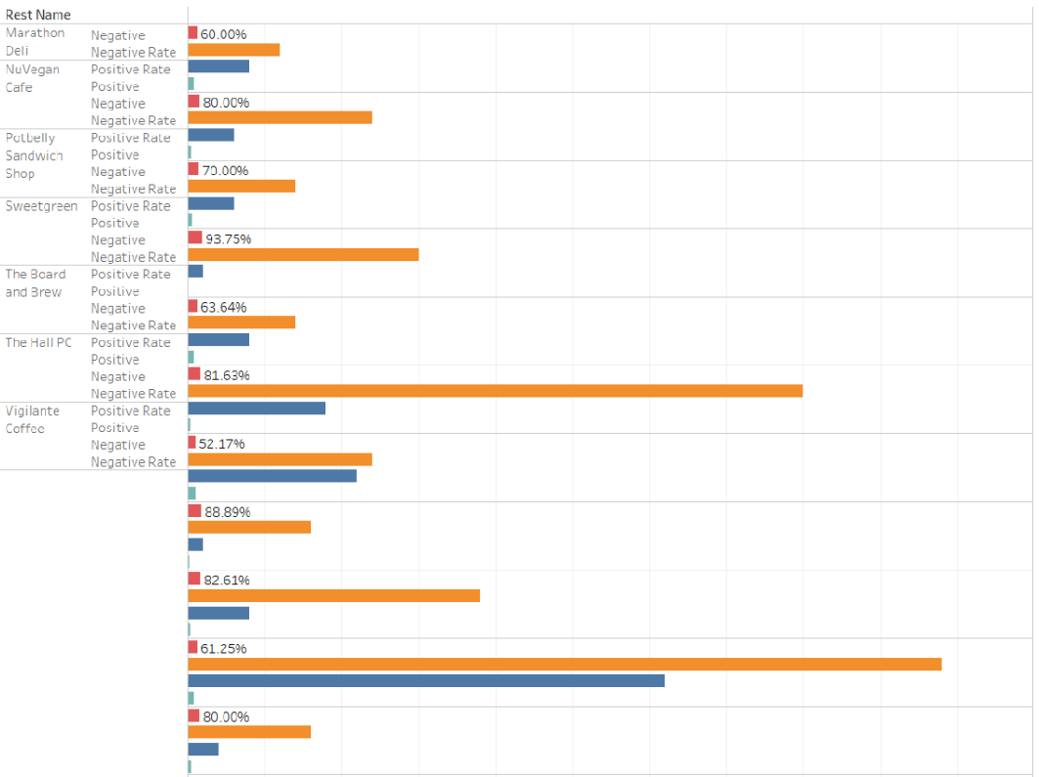

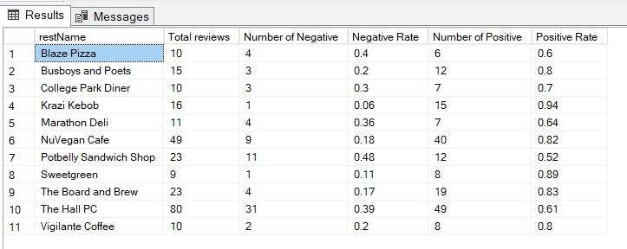
CASE 1: Business Transaction & Application (Cont)
CASE 1: How many negative/positive reviews each restaurant received? And what about their rate?
Top 3:
Krazi Kebob (93.79%)
Sweetgreen (88.89%)
The Board and Brew (82.61%)

Slide 13
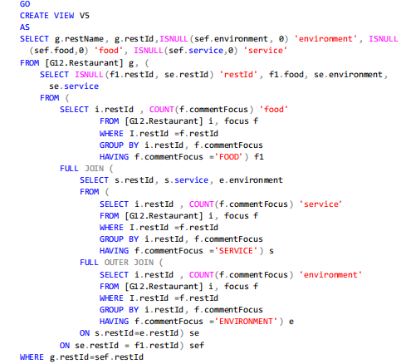
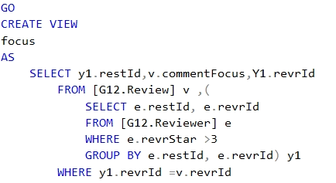
CASE 2: Business Transaction & Application
What is the distribution of reviews which higher than 4 stars for each restaurants?
The distribution is categorized within ‘environment/ food/ service’

Slide 14
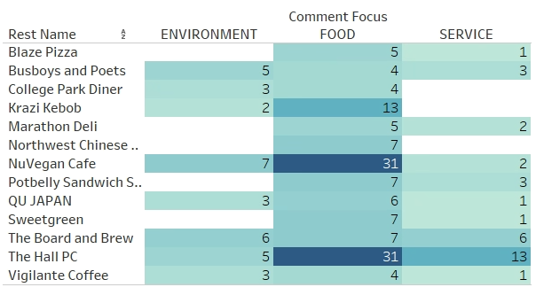
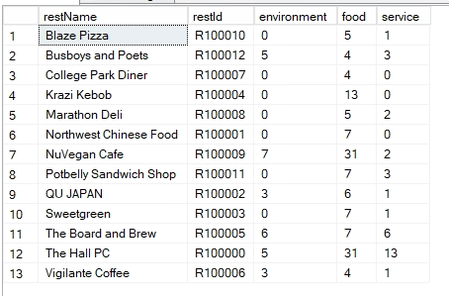
CASE 2: Business Transaction & Application（Cont）
What is the relative distribution of reviews which higher than 4 stars for each restaurants?
The distribution is categorized within ‘environment/ food/ service’

Slide 15
Thank you!
Questions?

